Slide 1
منظومة ادارة البصمة والمعالم الحيوية Fingerprint & Biometrics Management
مقدمة وعرض مختصر
Biometric Identity Determination & Verification
أغسطس 2015

Slide 2
الأجندة
الجوانب الرئيسية للمعالم الحيوية Roman
Main Biometric methods:
Authentication: Process of Identification vs. Verification
What are the Biometric features: Fingerprints, Facial, IRIS & Voice
Comparison on: A) accuracy, B) speed of retrieval & C) drawbacks of each method
التطبيقات الرئيسية؟ Roman
Key Applications:
Sensitive & High security Government buildings
Border points
Refineries
Large-scale enrolment.
ادارة الهوية مقابل ادارة الصلاحية؟
Identity management vs. access management (Roman & Salman)
الأجهزة المستعملة – devices used : Salman
رحلة شركة الخدمات العامة مع منظومة ادارة البصمة : Salman
عرض للجوانب الرئيسية لمنظومة ادارة البصمة: Roman – overview the last 5 slides

Slide 3
Verification vs Identification
Verification refers to the information you need to obtain to confirm that your clients are who they say they are. It is based upon validating a biometric sample presented against a previously collected biometric sample for the individual.
1:1 matching;
requires an ID plus a biometric template for the matching;
Fast processing, involves only one matching;
Scenario:
A person is asked to provide an ID;
A fingerprint captured by a fingerprint reader;
An application then searches a database for a record registered with the given ID;
The application retrieves the content of the template fields previously saved in a record;
The application uses the Fingerprint Verification SDK to compare the captured template with the retrieved from the record;
The user is authenticated only if the matching returns true;

Slide 4
Identification system seeks to identify an unknown person, it is based upon comparison of biometric sample presented against a database of previously collected samples.
1:N matching;
Does not require an ID, only a biometric template for the matching;
Processing time dependent on N (the number) of templates;
Scenario:
A fingerprint captured by a fingerprint reader;
An application starts to iterate through all user records in a database;
The application retrieves the content of the template for each user in the database;
The application uses the Fingerprint Identification SDK to compare the captured template with the retrieved from the record;
The user is authenticated only if the matching returns true otherwise it keeps on doing the loop;

Slide 5

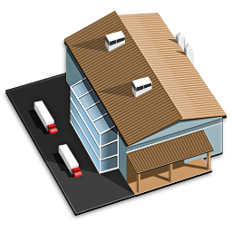



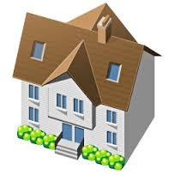

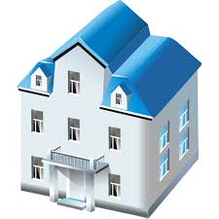

Slide 6
عرض للجوانب الرئيسية لمنظومة ادارة البصمة:
The next 5 slides show these aspects of biometrics: (For Roman to complete) – also Roman: we may need to re do the pictures for someone Arab looking.
Facial
Finger print

Slide 7
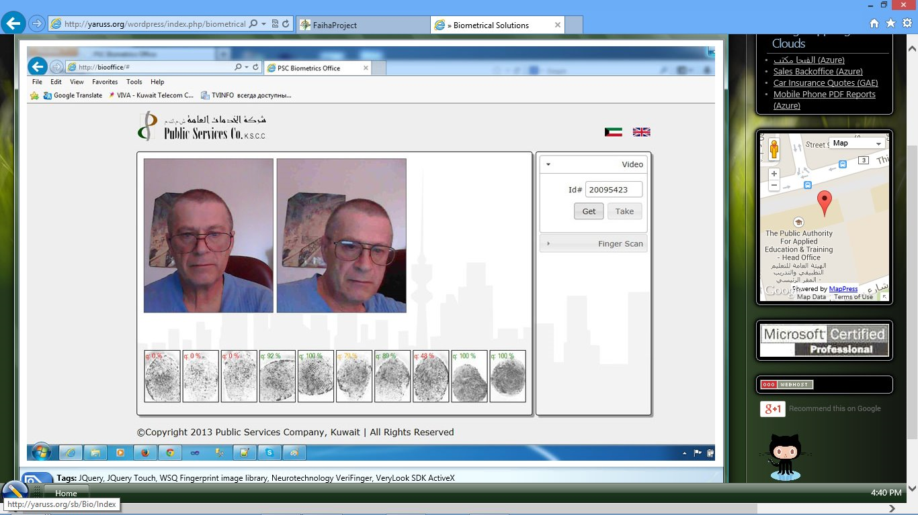

Slide 8
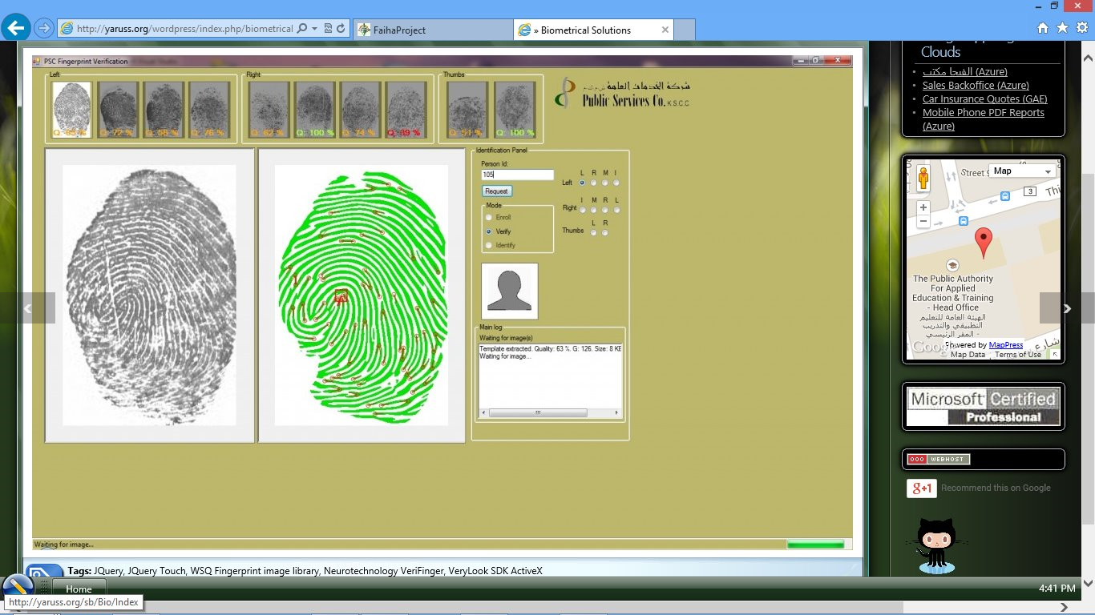

Slide 9
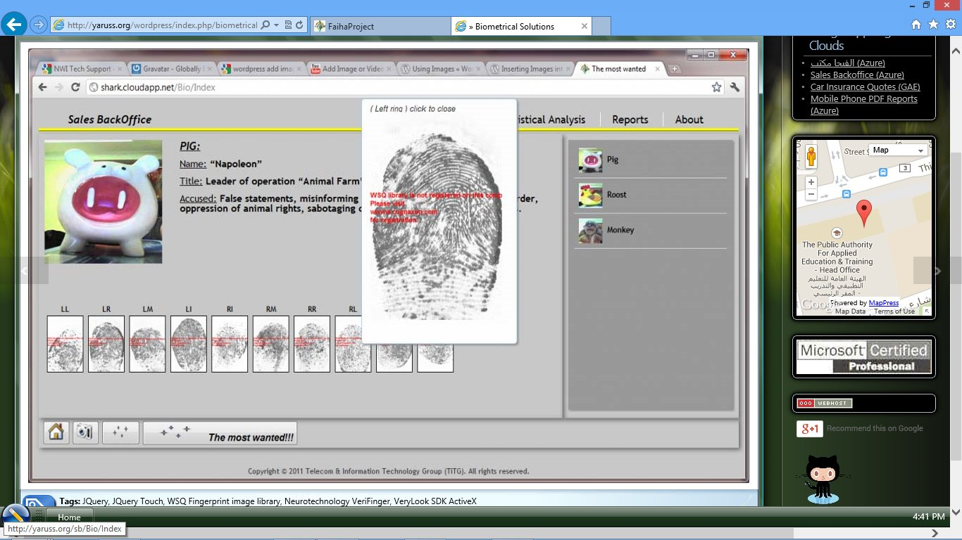

Slide 10
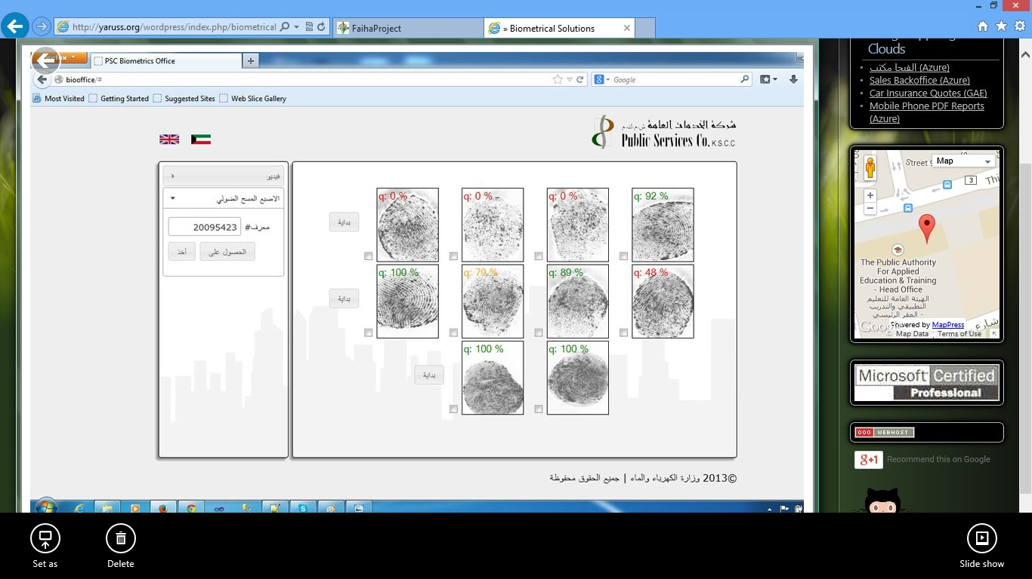

Slide 11
